Slide 1
Multitenant Technology
Karthikeyan S

Slide 2


Slide 3
What is MT ?
The multitenant application design was created to enable multiple users (tenants) to access the same application logic simultaneously.
Multitenancy, is a software architecture in which multiple single instances of software run on a single physical server. The server then serves multiple tenants.
Each tenant has its own view of the application that it uses, administers, and customizes as a dedicated instance of the software while remaining unaware of other tenants that are using the same application.

Slide 4
“Tenants” is a term for a group of users or software applications that all share access to the hardware through the underlying software.
This is the opposite of single-tenancy, in which the server runs one instance of the operating system and one application. This one application could be something simple like file and print apps, complex like Web or application servers, or mission-critical, such as a database.

Slide 5
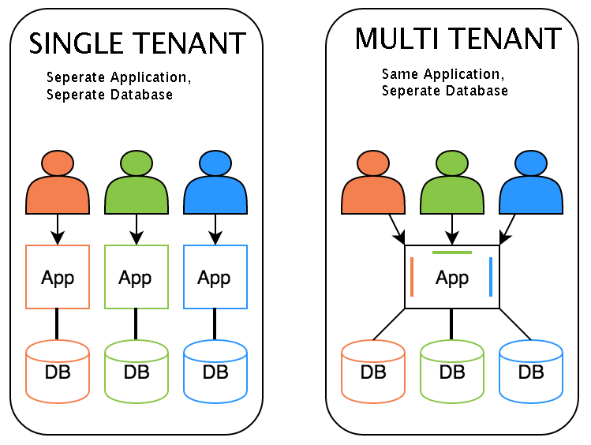
Example

Slide 6
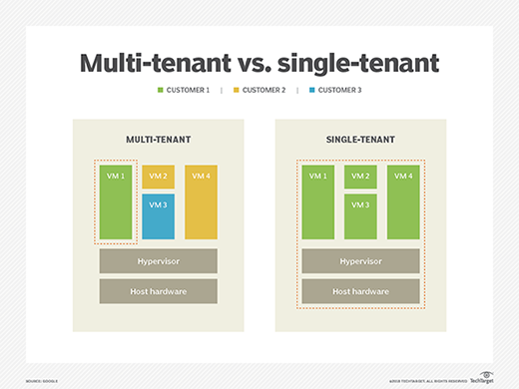

Slide 7
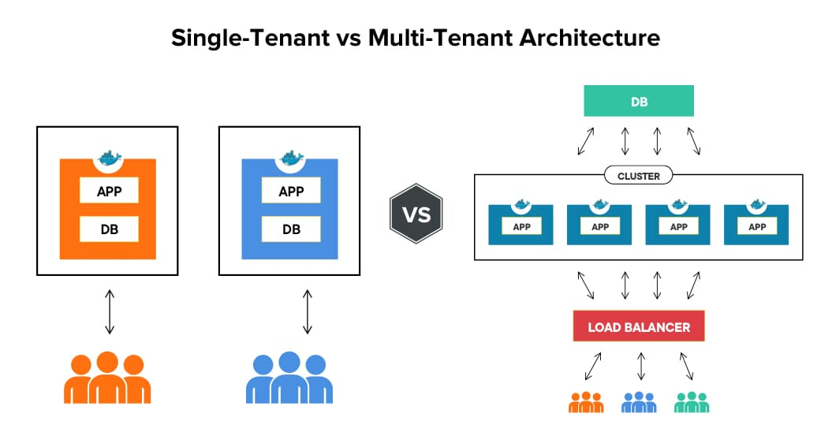

Slide 8
usecases
In the modern era, multitenancy is part and parcel with software-as-a-service model like Salesforce, Office 365, Zoho, Box, Zendesk, Slack, and many more applications on demand.
As mentioned above, cloud providers do offer multitenancy, in a technique of shared use of computing resources.

Slide 9
Tenants can individually customize features of the application, such as:
Multitenant applications ensure that tenants do not have access to data and configuration information that is not their own.
Tenants can individually customize features of the application, such as:
• User Interface – Tenants can define a specialized “look and feel” for their application interface.
• Business Process – Tenants can customize the rules, logic, and workflows of the business processes that are implemented in the application.
• Data Model – Tenants can extend the data schema of the application to include, exclude, or rename fields in the application data structures.
• Access Control – Tenants can independently control the access rights for users and groups.

Slide 10
MT is More Complex
Multitenant application architecture is often significantly more complex than that of single-tenant applications.
Multitenant applications need to support the sharing of various artifacts by multiple users (including portals, data schemas, middleware, and databases), while maintaining security levels that segregate individual tenant operational environments.

Slide 11
Common characteristics of multitenant applications include:
• Usage Isolation – The usage behaviour of one tenant does not affect the application availability and performance of other tenants.
• Data Security – Tenants cannot access data that belongs to other tenants.
• Recovery – Backup and restore procedures are separately executed for the data of each tenant.
• Application Upgrades – Tenants are not negatively affected by the synchronous upgrading of shared software artifacts.
• Scalability – The application can scale to accommodate increases in usage by existing tenants and/or increases in the number of tenants.
• Metered Usage – Tenants are charged only for the application processing and features that are actually consumed.
• Data Tier Isolation – Tenants can have individual databases, tables, and/or schemas isolated from other tenants. Alternatively, databases, tables, and/or schemas can be designed to be intentionally shared by tenants.

Slide 13
Single-Tenant vs. Multi-Tenant
Single-tenancy is largely seen as the "deluxe" option, in that a client operates in a solely dedicated environment.
In a multi-tenant environment, each customer shares the software application along with a single database, so multiple people from the same company can access the database. Still, even in multi-tenant, each tenant is isolated from other tenants.

Slide 14
Advantages of Single-Tenant Hosting
Single-tenant hosting gives clients more control because there is no sharing of resources. This manifests in a number of ways:
Greater customization: Since they have only client, single tenants can customize the software for their needs, whereas multi-tenant tends to be one-size-fits-all.
Greater isolation from security risks: You control the environment and (hopefully) what goes in and out of it.
Faster recovery: Restoring one client is faster and easier than many.
Better control: Single-tenant can be choosier about accepting software changes and updates and decide what add-ons they want to use.
Avoiding “noisy neighbor” syndrome: Since you are sharing resources in multi-tenant scenarios, someone else who is really heavily using the system might slow you down.

Slide 15
Disadvantages of Single-Tenant Hosting
Though some companies prefer it, there are downsides to single-tenancy.
Cost: There is no cost sharing for things like balancing, services, system monitoring, and deployment.
Client responsibility: Clients are responsible for software updates, patches, backup, restore, and disaster recovery.
Less efficient: Single-tenant systems can be less efficient if they don’t run at full capacity or if they are over-provisioned.

Slide 16
Advantages of Multi-Tenant Hosting
The chief advantage of multi-tenant hosting is that it is less expensive.
The resource pooling greatly reduces the cost since you only pay for what you need. And since multi-tenant is part of a SaaS provider, you are not paying for on-premises hardware.
Simplified hosting: It’s not your hardware to manage any more, reducing a lot of time and expense.
Better protection of systems: With less interaction with the outside world, exposure to malicious software is reduced.
Upgrading software is no longer your problem: You always get the latest version of software pushed out to you by the provider.

Slide 17
Disadvantages of Multi-Tenant Hosting
They have their own security risks: For starters, you need strict authentication and access controls to make sure the right people get access. Second, data corruption could possibly spread from one user to all, though precautions guard against this.
Downtime: Outages can be nationwide, and often make the news when they happen. SaaS providers tend to build enough redundancy into the system to minimize this.
Noise neighbors: As mentioned earlier, someone else on your CPU might be consuming cycles and slowing you down. Capacity is supposed to be elastic and expand as needed but that’s not always the case.

Slide 18
There are three ways to architect your database in a multi-tenant system.
A single, shared database schema
Single database, multiple schemas
Multiple databases

Slide 19
Most of the example conform to these three ways to structure a multi-tenant application:
URL-based SaaS. This is the easiest one to do since it uses a single domain and database. You would have specific URLs, like subdomain1.maindomain.com, subdomain2.maindomain.com, etc. Data management and security is handled at the application level. Some SaaS operates this way, especially those that put a Web app interface between the user and the database.
Multi-tenant SaaS. This is more complex because of multiple databases and/or schemas, and restrictions are done at the database level. This is how many SaaS apps operate and often allow more direct interaction with the database.
Virtualization-based SaaS, like containers. This is the most complex setup because there is so much interaction between the containers as well as the apps and databases. That’s why there is so much emphasis on orchestrators like Docker and Kubernetes.

Slide 20
Multitenancy vs. Virtualization
Multitenancy is sometimes mistaken for virtualization because the concept of multiple tenants is similar to the concept of virtualized instances.
The differences lie in what is multiplied within a physical server acting as a host:
With virtualization: Multiple virtual copies of the server environment can be hosted by a single physical server. Each copy can be provided to different users, can be configured independently, and can contain its own operating systems and applications.
With multitenancy: A physical or virtual server hosting an application is designed to allow usage by multiple different users. Each user feels as though they have exclusive usage of the application.

